Slide 1

An Accessible Open-Source Implementation of the Congruent Matching Cells Algorithms for Cartridge Case Analysis
Joe Zemmels, M.Sc.
Susan Vanderplas, Ph.D.
Heike Hofmann, Ph.D.
11:05-11:20 D38

Slide 2
Overview
Cartridge Case Breech Face Impression Analysis
The Congruent Matching Cells (CMC) Algorithms
The cmcR Package
Experimentation with the CMC Algorithms using cmcR

Slide 3
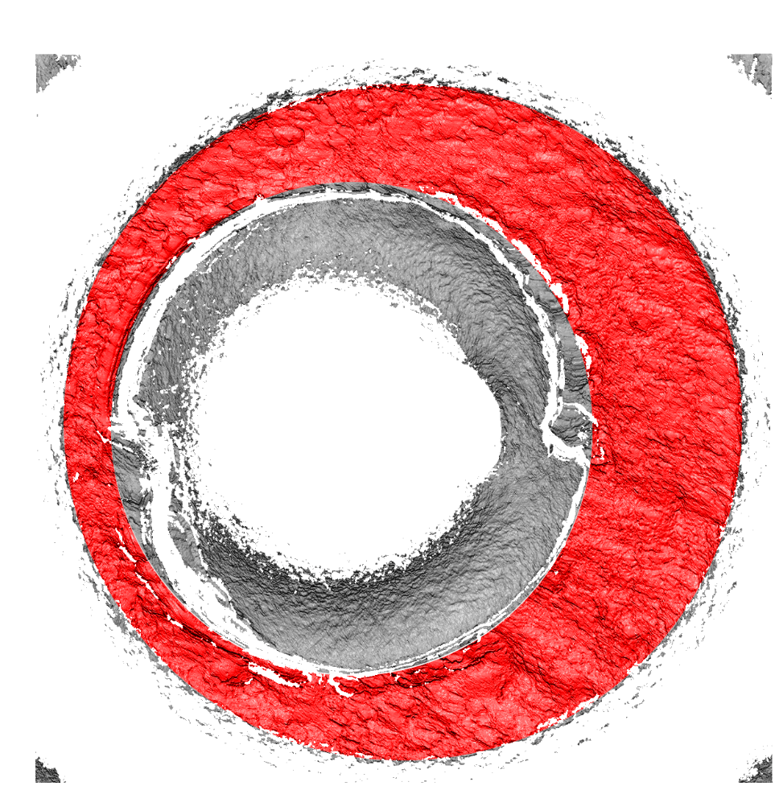
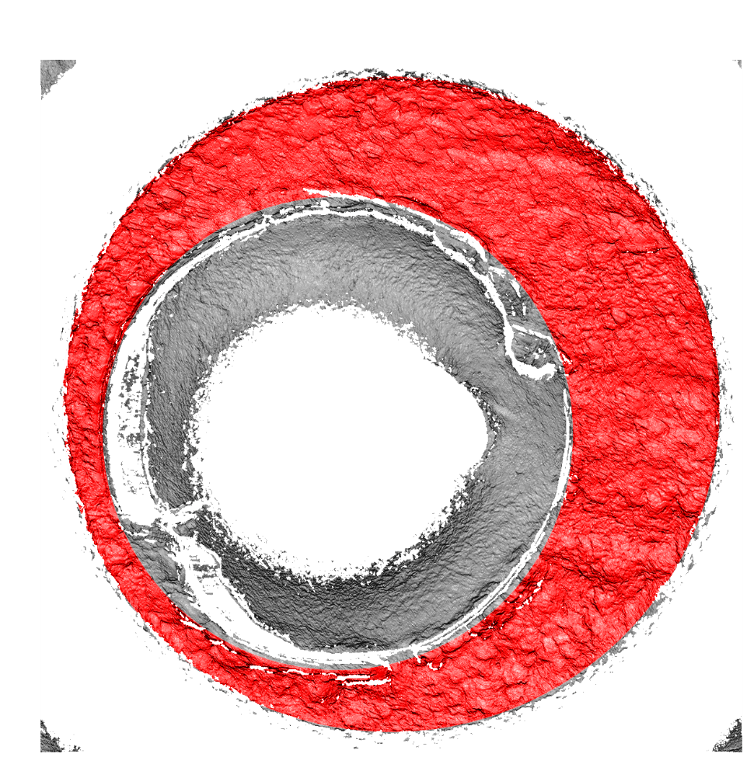
Cartridge Case Breech Face Impression Analysis
Notes:
I’m sure everyone in the audience is well-aware of cartridge case analysis.
However, to make sure we’re all on the same page

Slide 4
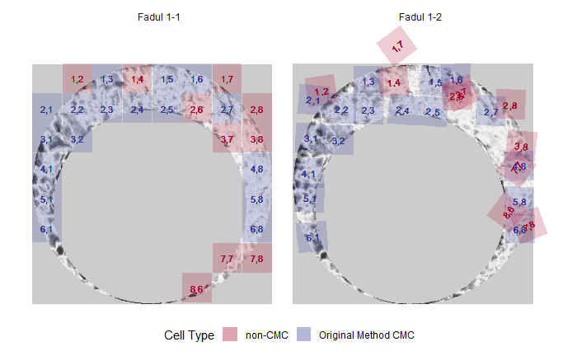
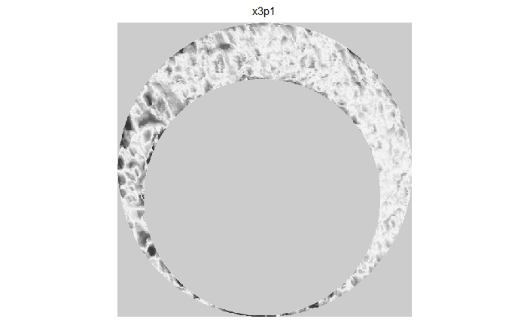
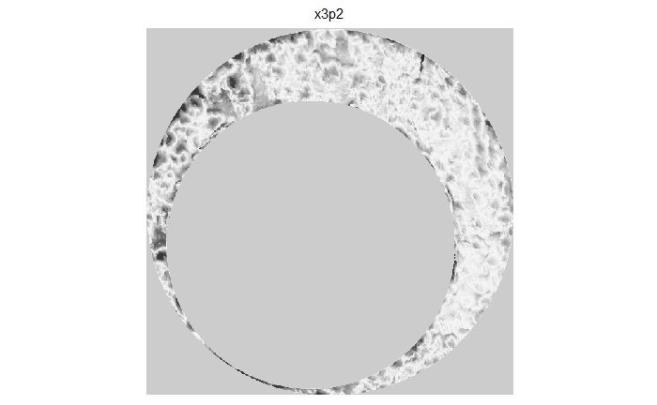
The Congruent Matching Cells Algorithms
Pre-process two cartridge case scans to highlight breech face impressions.
Divide one scan into a grid of “cells.”
Compare each cell to another cartridge case.
Classify cells as “congruent matching” if they match the other scan.
Measure similarity as the total number of “Congruent Matching Cells” (CMCs).
Relies on many user-defined parameter settings.
Notes:
A class of algorithms that are used in cartridge case analysis are the Congruent Matching Cells algorithms.
These algorithms compare cartridge cases based on their breech face impressions.
They were initially introduced in 2013 by John Song at NIST.
There have been numerous improvements and changes to the originally proposed algorithm, which is why I have the pluralized algorithm*s* throughout this presentation.
However, we can

Slide 5
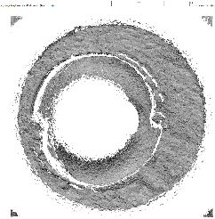
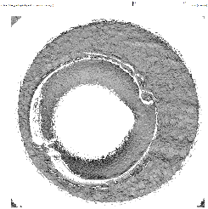
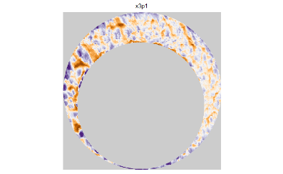
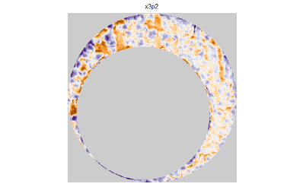

The cmcR package pipeline
Written open-source in the R statistical programming language.
Modularizes the CMC algorithms into single-purpose pieces.
Within each stage, pieces can be re-ordered & re-connected via “piping,” %>%
Stage
Initial Data
Pre-processing
Comparison
Final Results
Pipeline
preProcess_crop() %>%
Cartridge Cases %>%
preProcess_removeTrend() %>%
comparison_allTogether() %>%
decision_CMC()
preProcess_gaussFilter() %>%
Results

Slide 6
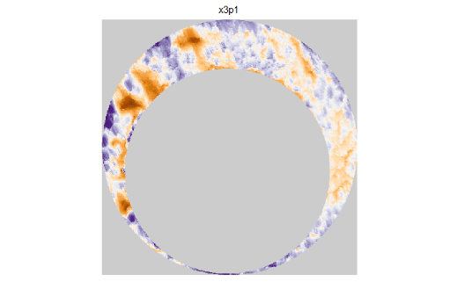
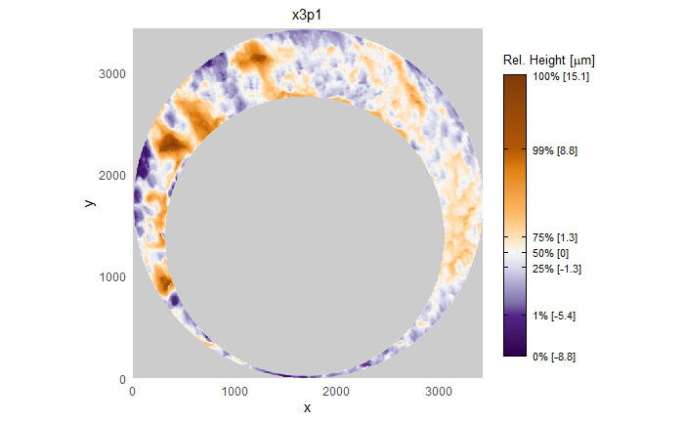

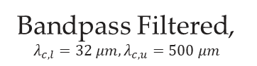
Experimentation with the CMC algorithms
What is effect of changing a piece of the pipeline?
What settings are optimal for a piece of the pipeline?
preProcess_crop() %>%
Cartridge Cases %>%
preProcess_removeTrend() %>%
comparison_allTogether() %>%
decision_CMC()
preProcess_gaussFilter() %>%
No Filter
Lowpass Filtered, $λ_{c,l}=32 μm$
Bandpass Filtered, $λ_{c,l}=32 μm,λ_{c,u}=500 μm$
Notes:
With this modularization, we can address questions such as “In what order should the pieces be arranged?”
Currently, no one has a definitive answer to this question, so a lot of experimentation with the CMC method is required
Additionally, we can address questions such as “what is the effect of changing a piece of the pipeline?”
Consider for example one step of the pipeline – the gaussian filter step.
For those of your unfamiliar, a Gaussian filter applies a local smoothing to the values of the cartridge case scan
The plots below show the same pairing of matching scans for various settings of this gaussian filter step.
On the left, we can see a scan with no gaussian filter applied.
In the center, we can see the same scan with a lowpass filter applied.
A lowpass filter applies local smoothing to the surface of the scan to reduce noise.
To our eye, it may not seem like the lowpass filter has done much to the scan, but if you look really closely you can see that some of the “speckle” on the non-filtered scan has been removed after applying the lowpass.
Finally, the right shows a bandpass filtered scan.
A bandpass filter applies a lowpass smoothing filter while also sharpening certain features in the scan.
Each of these filters comes with their own parameter settings – for those of you familiar, the wavelength cutoffs used for these filters are given on the slide.
The question becomes: how do we choose amongst these different parameter settings?

Slide 7
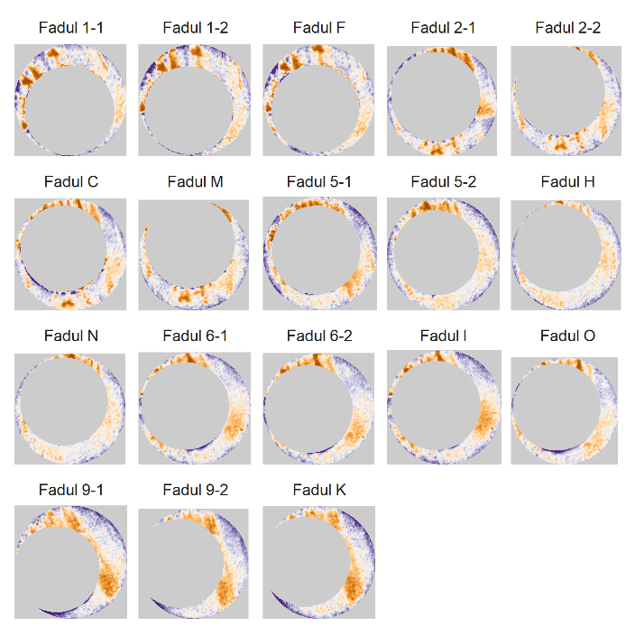
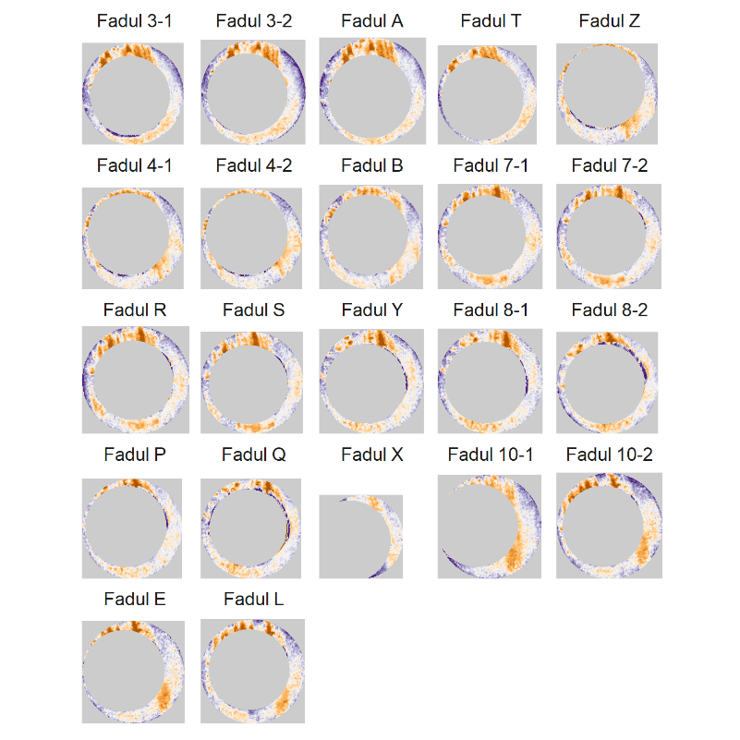
How do we find and validate the “best” settings?
Consider 40 cartridge cases from 10 barrels (Fadul et al., 2011)
Randomly split into 5 training barrels/5 test barrels.
“Learn” parameters based on the train set, validate them on the test set.
18 Training Scans
22 Test Scans

Slide 8
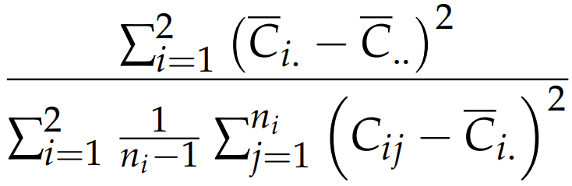
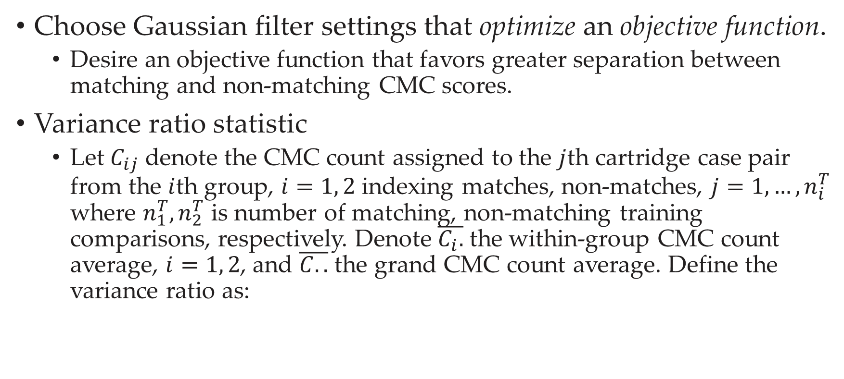
How do we learn parameter settings?
Choose Gaussian filter settings that optimize an objective function.
Desire an objective function that favors greater separation between matching and non-matching CMC scores.
Variance ratio statistic
Let $C_{ij}$ denote the CMC count assigned to the $j$th cartridge case pair from the $i$th group, $i=1, 2$ indexing matches, non-matches, $j=1,…,n_{i}^{T}$ where $n_{1}^{T}, n_{2}^{T}$ is number of matching, non-matching training comparisons, respectively. Denote $\overline{C_{i}.}$ the within-group CMC count average, $i=1, 2$, and $\overline{C..}$ the grand CMC count average. Define the variance ratio as:

Slide 9
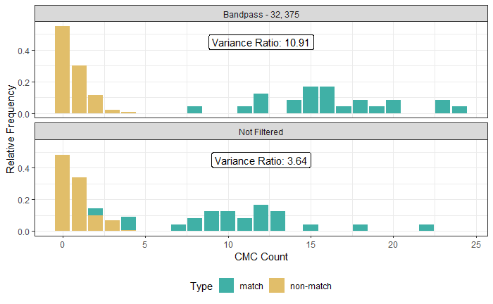
How do we define “best?”
Larger variance ratios imply greater separation between & less variability within the matching & non-matching distributions.

Slide 10
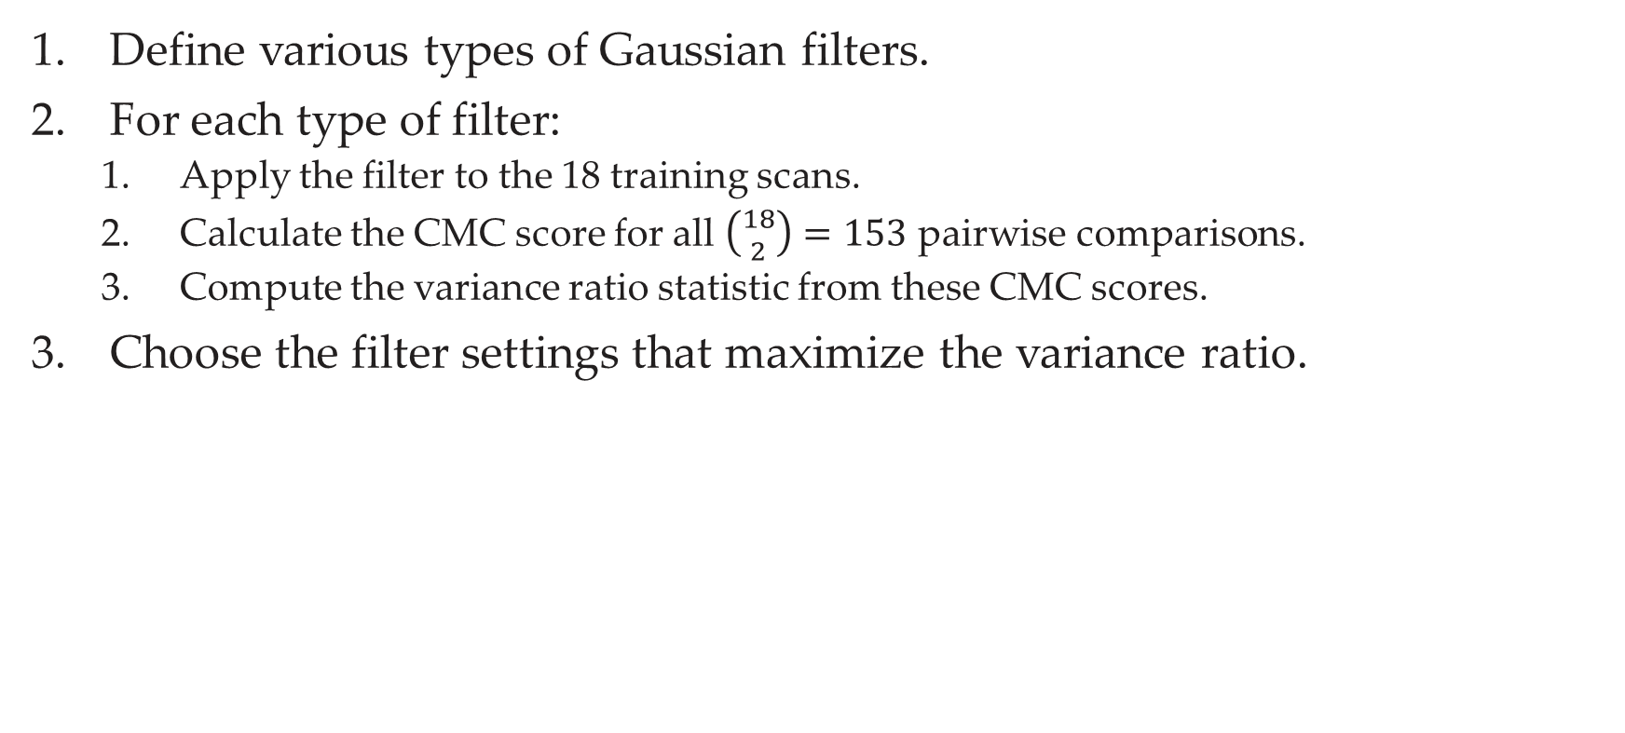
Learning the optimal filter settings
Define various types of Gaussian filters.
For each type of filter:
Apply the filter to the 18 training scans.
Calculate the CMC score for all $\left({18 \atop 2}\right)=153$ pairwise comparisons.
Compute the variance ratio statistic from these CMC scores.
Choose the filter settings that maximize the variance ratio.

Slide 11
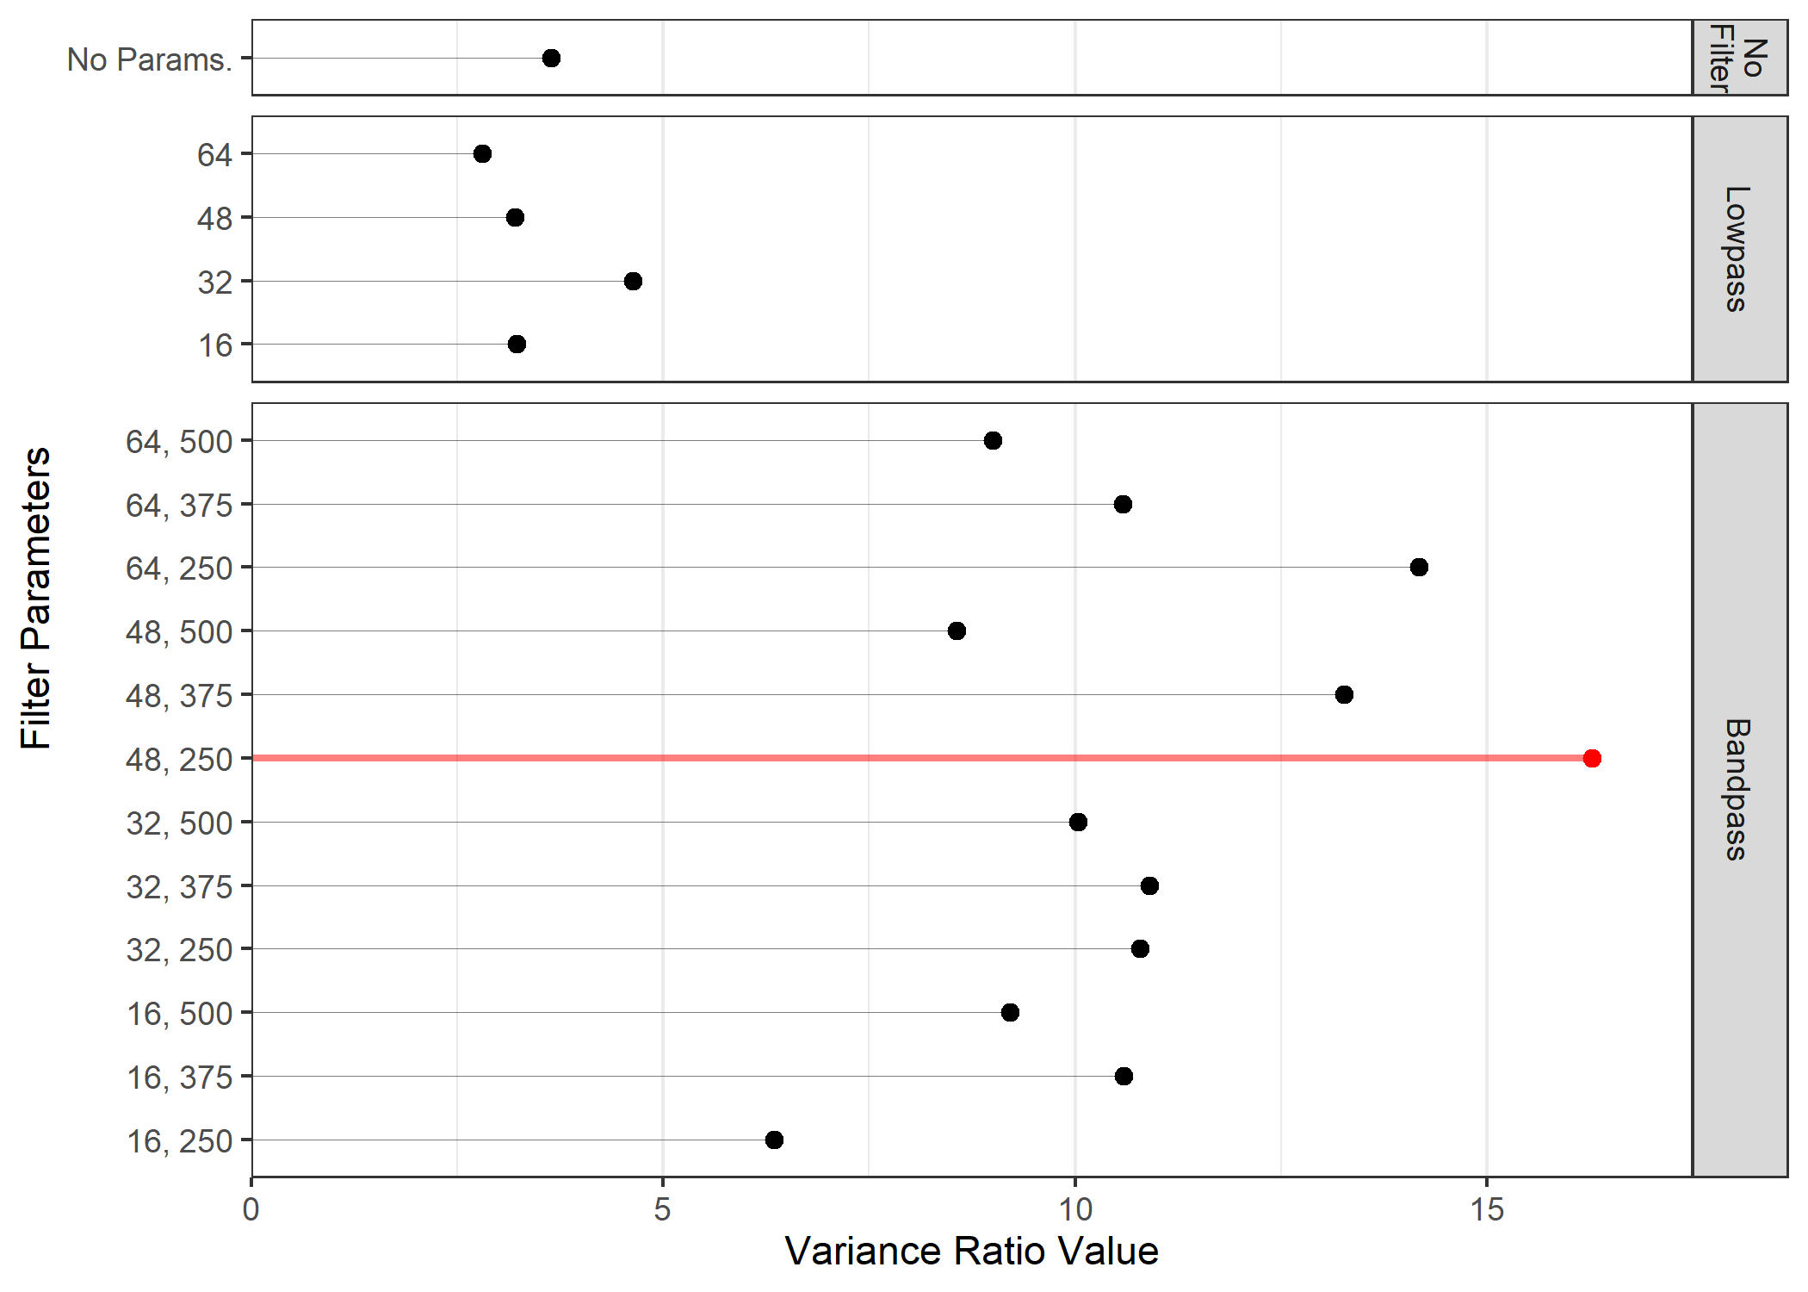
Learning the optimal filter settings

Slide 12
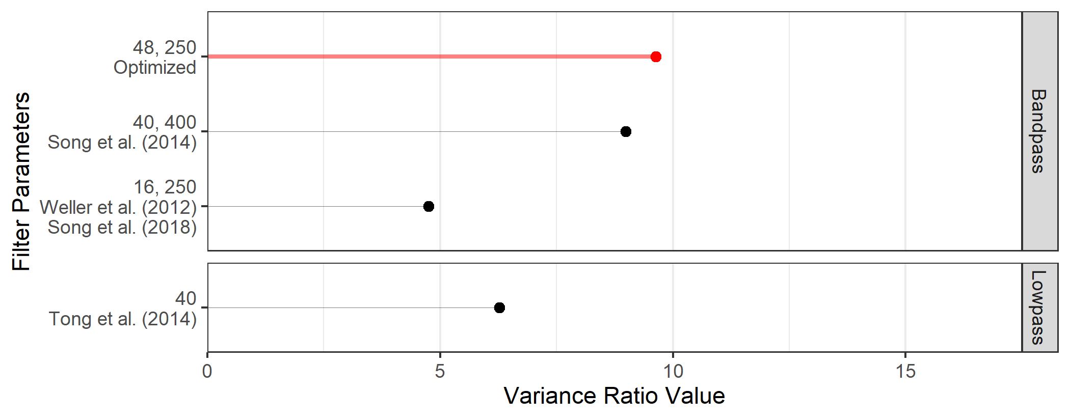
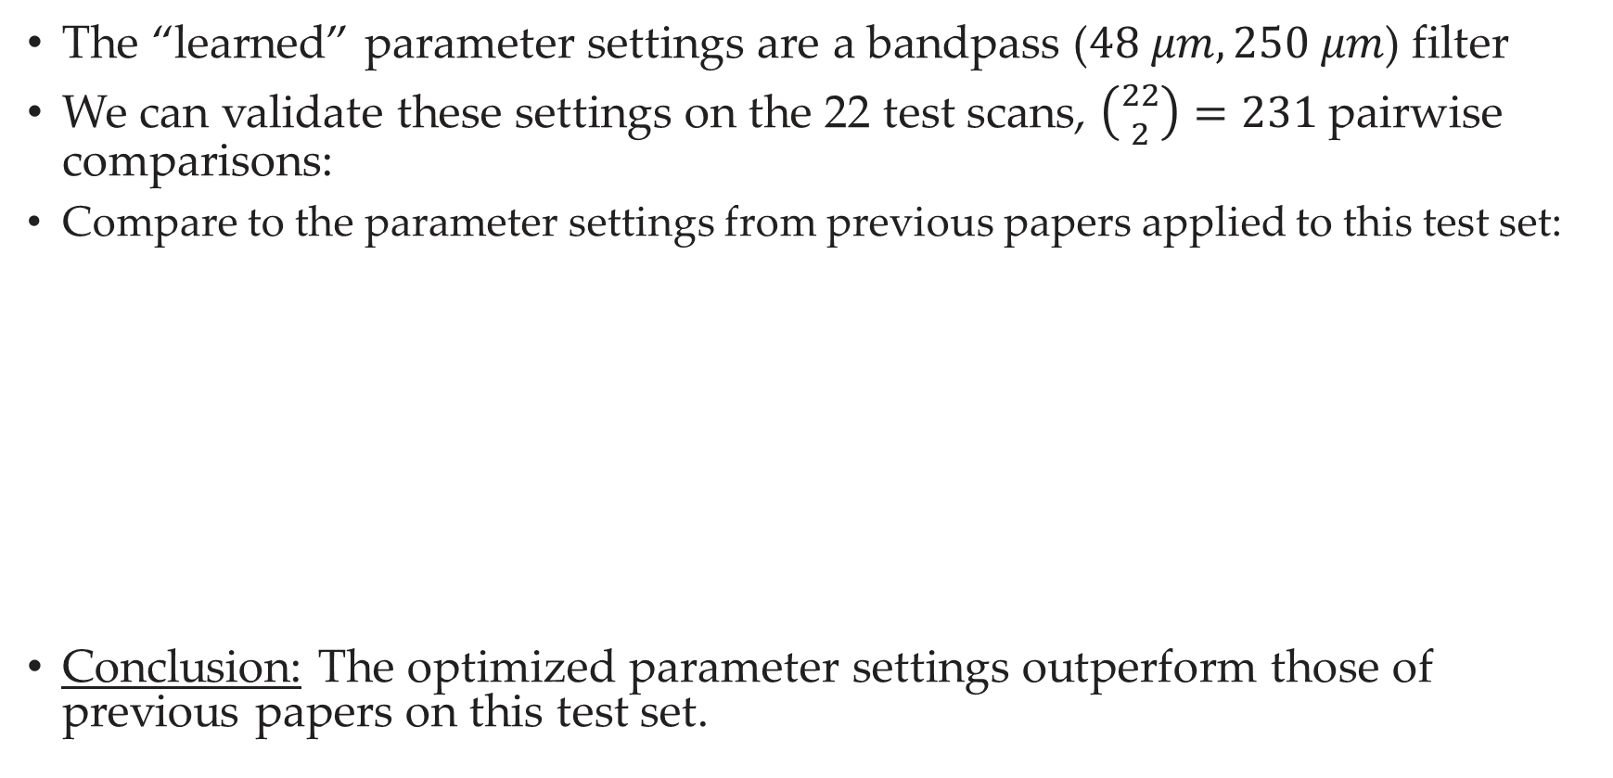
Testing the filter settings
The “learned” parameter settings are a bandpass ($48 μm, 250 μm$) filter
We can validate these settings on the 22 test scans, $\left({22 \atop 2}\right)=231$pairwise comparisons:
Compare to the parameter settings from previous papers applied to this test set:
Conclusion: The optimized parameter settings outperform those of previous papers on this test set.

Slide 13
Conclusion
Much experimentation is still needed to determine the optimal settings of the CMC algorithms.
Our modularization of the algorithms, along with a train/test validation procedure, enables this experimentation.
cmcR provides an accessible, open-source implementation of the CMC algorithms for further learning & experimentation.

Slide 14
Resources
cmcR Source Code: https://github.com/CSAFE-ISU/cmcR
Email: jzemmels@iastate.edu
Code for these slides: https://github.com/jzemmels/aafs22_slides
NIST Ballistics Database: https://tsapps.nist.gov/NRBTD/
Free resources to learn R
An Introduction to R: https://intro2r.com/
R for Data Science: https://r4ds.had.co.nz/

Slide 15
References
J. Song. (2013). Proposed “NIST Ballistics Identification System (NBIS)” Based on 3D Topography Measurements on Correlation Cells. American Firearm and Tool Mark Examiners Journal, 45(2):11.
T. Fadul, G. Hernandez, S. Stoiloff, and G. Sneh. (2011). An Empirical Study to Improve the Scientific Foundation of Forensic Firearm and Tool Mark Identification Utilizing 10 Consecutively Manufactured Slides.
J. Song, W. Chu, M. Tong, and J. Soons. 3D topography measurements on correlation cells—a new approach to forensic ballistics identifications. Measurement Science and Technology, 25(6):064005, June 2014. ISSN 0957-0233, 1361-6501.
T. J. Weller, A. Zheng, R. Thompson, and F. Tulleners. Confocal microscopy analysis of breech face marks on fired cartridge cases from 10 consecutively manufactured pistol slides. 57(4), mar 2012. doi: 10.1111/j.1556-4029.2012.02072.x.
J. Song, T. V. Vorburger, W. Chu, J. Yen, J. A. Soons, D. B. Ott, and N. F. Zhang. Estimating error rates for firearm evidence identifications in forensic science. Forensic Science International, 284:15–32, Mar. 2018. ISSN 03790738.
M. Tong, J. Song, W. Chu, and R. M. Thompson. Fired Cartridge Case Identification Using Optical Images and the Congruent Matching Cells (CMC) Method. Journal of Research of the National Institute of Standards and Technology, 119:575, Nov. 2014. ISSN 2165-7254.
Zemmels, J. Hofmann, H. Vanderplas, S. (2021). cmcR: An Implementation of the ‘Congruent Matching Cells’ Method. R package version 0.1.8.
Milton Bache, S. Wickham, H. (2020). magrittr: A Forward-Pipe Operator for R. R package version 2.0.1.
Douglas, A. Ross, D. Mancini, F. Couto, A. Lusseau, D. (2021) An Introduction to R.
Grolemund, G., & Wickham, H. (2017). R for Data Science. O’Reilly Media.

Slide 16
Thank You!
Questions?

